Slide 1
Control Statements & Decision-Making in C

Slide 2
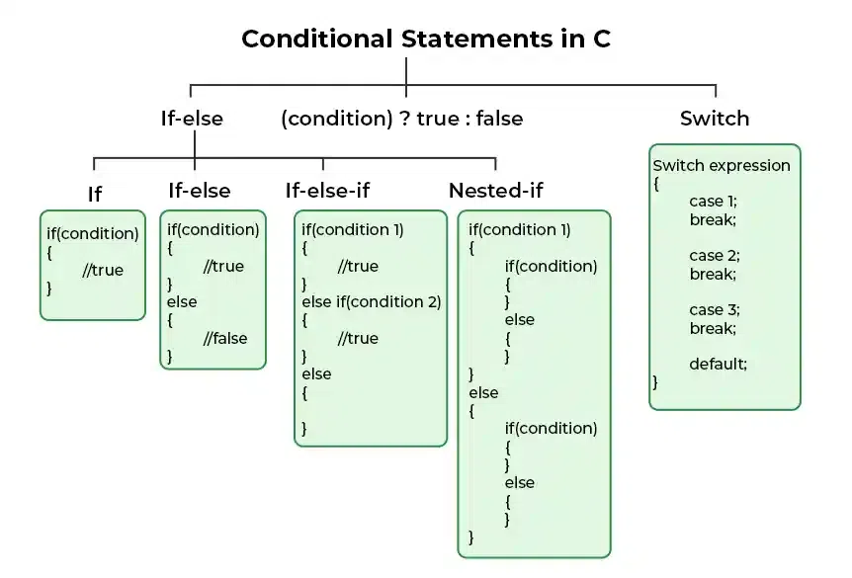
Decision Making in C (if , if..else, Nested if, if-else-if )

Slide 3
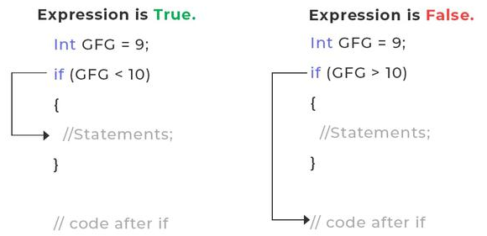
C – if Statement
Syntax of if Statement in C
if(condition)
{
// if body
// Statements to execute if condition is true
}
// The syntax of if statement
#include <stdio.h>
int main()
{
int gfg = 9;
// if statement with true condition
if (gfg < 10)
{
printf("%d is less than 10", gfg);
}
// if statement with false condition
if (gfg > 20) {
printf("%d is greater than 20", gfg);
}
}
Output: 9 is less than 10
How if in C works?

Slide 4
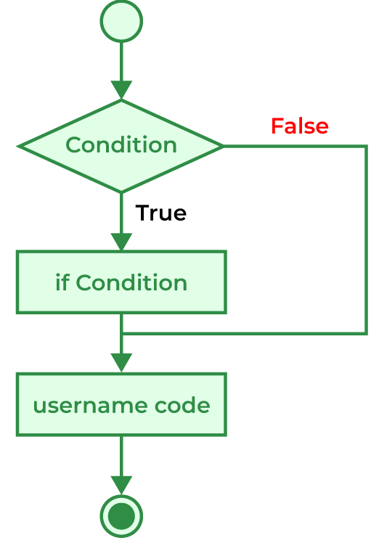
The working of the if statement in C is as follows:
STEP 1: When the program control comes to the if statement, the test expression is evaluated.
STEP 2A: If the condition is true, the statements inside the if block are executed.
STEP 2B: If the expression is false, the statements inside the if body are not executed.
STEP 3: Program control moves out of the if block and the code after the if block is executed.
Flowchart of if in C

Slide 5
Example 1: C Program to check whether the number is even or odd.
Can we specify multiple conditions in if statement?
We can specify multiple conditions in the if statement but not separately. We have to join these multiple conditions using logical operators making them into a single expression. We can then use this expression in the if statement.
Valid Expressions
if (a < b && a < c);
if (a == 25 || a < 25);
Invalid Expressions
if (a < b, a < c);
#include <stdio.h>
int main(){
int n = 4956;
// condition to check for even number
if (n % 2 == 0) {
printf("%d is Even", n);
}
// condition to check for odd number
if (n % 2 == 1) {
printf("%d is Odd", n);
}
}
Output: 4956 is Even

Slide 6
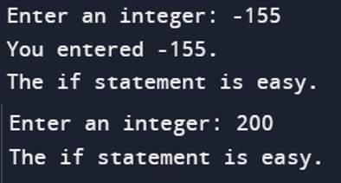
// Program to display a number if it is negative
#include <stdio.h>
int main() {
int number;
printf("Enter an integer: ");
scanf("%d", &number);
// true if number is less than 0
if (number < 0) {
printf("You entered %d.\n", number);
}
printf("The if statement is easy.");
}

Slide 7
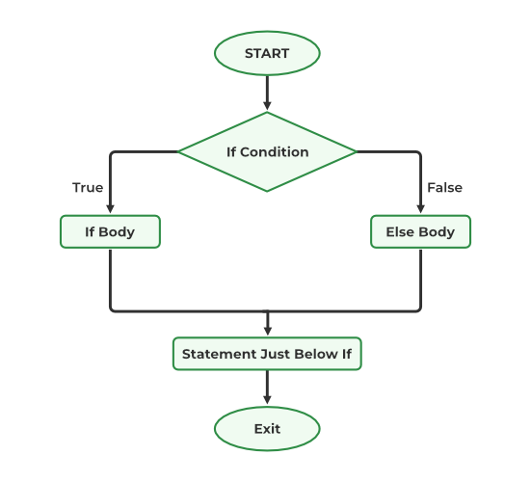
Flowchart of the if-else statement
C if-else Statement
Syntax of if-else
if (condition)
{
// code executed when the condition is true
}
else
{
// code executed when the condition is false
}
Conditions and If Statements
Less than: a < b
Less than or equal to: a <= b
Greater than: a > b
Greater than or equal to: a >= b
Equal to a == b
Not Equal to: a != b

Slide 8
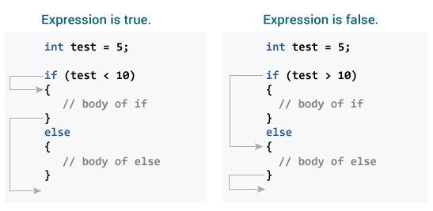
Q-1: How if-else Statement works?
Working of the if-else statement in C is explained below:
When the program control first comes to the if-else block, the test condition is checked.
If the test condition is true:
The if block is executed.
If the test condition is false:
The else block is executed
After that, the program control continues to the statements below the if-else statement.
Q-2: Can we skip second braces{} around the body of the if-else block in C?
Answer:
We can skip the braces of the body of the if or else block as long as there is only a single statement inside their body. We will get an error if there is more than one statement in the body without braces.

Slide 9
We can also test variables:
Example
int x = 20;
int y = 18;
if (x > y) {
printf("x is greater than y");
}
// C Program to demonstrate the use of if-else statement
#include <stdio.h>
int main(){
// if block with condition at the start
if (5 < 10) {
// will be executed if the condition is true
printf("5 is less than 10.");
}
// else block after the if block
else {
// will be executed if the condition is false
printf("5 is greater that 10.");
}
}
Output: 5 is less than 10.
Example
int time = 20; if (time < 18) { printf("Good day."); } else { printf("Good evening."); } // Outputs "Good evening."

Slide 10
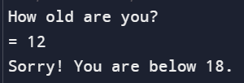
Find out if a person is old enough to vote:
#include<stdio.h>
int main(){
int myAge;
int votingAge = 18;
printf("How old are you? \n= ");
scanf("%d", &myAge);
if( myAge >= votingAge){
printf("Yes! You can vote.\n");
}
else{
printf("Sorry! You are below 18.\n");
}
}
Example 2: C Program to check whether a given number is even or odd
#include <stdio.h>
int main(){
int num;
printf("Enter an integer: ");
scanf("%d", &num);
if (num % 2 == 0) {
printf("Number is even");
}
else {
printf("Number is Odd");
}
}
Output: Number is even

Slide 11
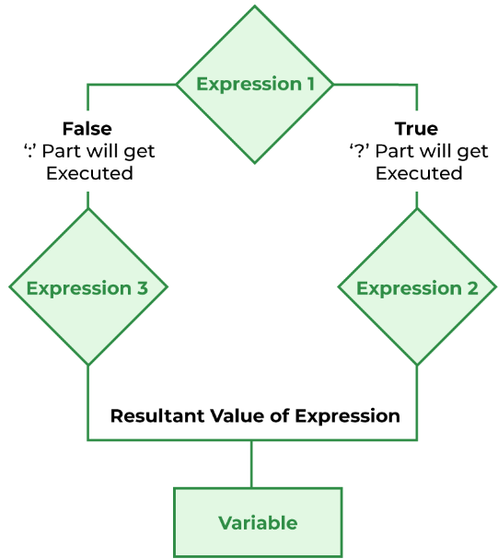
C Short Hand If Else / Conditional Operator
There is also a short-hand if else, which is known as the ternary operator because it consists of three operands. It can be used to replace multiple lines of code with a single line. It is often used to replace simple if else statements:
Syntax
variable = (condition) ? expressionTrue : expressionFalse;
Flowchart of Conditional Operator
Example
int time = 20; if (time < 18) { printf("Good day."); }
else { printf("Good evening."); }
Example
int time = 20; (time < 18) ? printf("Good day.") : printf("Good evening.");

Slide 12
// C Program to illustrate the use of conditional operator
#include <stdio.h>
int main() {
int check = 0;
result = (check == 0) ? 25 : -25;
printf("Value of var when flag is 0: %d\n", result);
check=1;
result = (check == 0) ? 25 : -25;
printf("Value of var when flag is NOT 0: %d", result);
}
Output:
Value of result when check is 0: 25
Value of result when check is NOT 0: -25
// C program to find largest among two
// numbers using ternary operator
#include <stdio.h>
int main()
{
int m = 5, n = 4;
(m > n) ? printf("m is greater than n that is %d > %d",
m, n)
: printf("n is greater than m that is %d > %d",
n, m);
return 0;
}

Slide 13
#include <stdio.h>
int main() {
int age;
// take input from users
printf("Enter your age: ");
scanf("%d", &age);
// ternary operator to find if a person can vote or not
(age >= 18) ? printf("You can vote") : printf("You cannot vote");
return 0;
}
#include <stdio.h>
int main() {
// create variables
char operator = '+';
int num1 = 8;
int num2 = 7;
// using variables in ternary operator
int result = (operator == '+') ? (num1 + num2) : (num1 - num2);
printf("%d", result);
return 0;
}
// Output: 15
#include <stdio.h>
int main() {
int number = 3;
(number % 2 == 0) ? printf("Even Number") : printf("Odd Number");
return 0;
}

Slide 14
The else if Statement
Use the else if statement to specify a new condition if the first condition is false.
Syntax
if (condition1) {
// block of code to be executed if condition1 is true
}
else if (condition2) {
// block of code to be executed if the condition1 is false and condition2 is true
}
else {
// block of code to be executed if the condition1 is false and condition2 is false
}
Example
int time = 22; if (time < 10) { printf("Good morning."); }
else if (time < 20) { printf("Good day."); }
else { printf("Good evening."); }
// Outputs "Good evening."

Slide 15
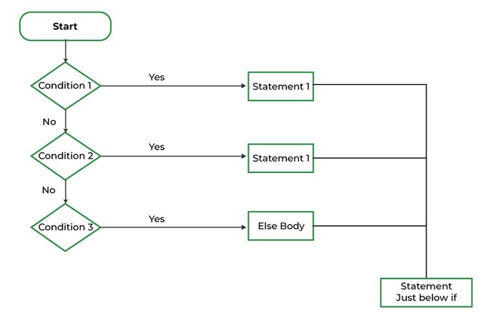
// C program to illustrate if-else-if statement
#include <stdio.h>
int main() {
int i = 20;
if (i == 10)
printf("i is 10");
else if (i == 15)
printf("i is 15");
else if (i == 20)
printf("i is 20");
else
printf("i is not present");
}
Output: i is 20
Flowchart of if-else-if Ladder

Slide 16
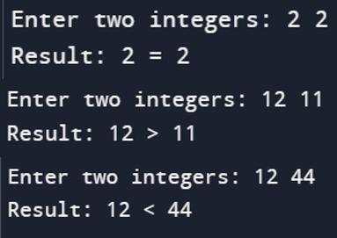
// Program to compare two integers using =, > , <
#include <stdio.h>
int main() {
int number1, number2;
printf("Enter two integers: ");
scanf("%d %d", &number1, &number2);
if(number1 == number2) {
printf("Result: %d = %d",number1,number2);
}
else if (number1 > number2) {
printf("Result: %d > %d", number1, number2);
}
else {
printf("Result: %d < %d",number1, number2);
}
}
This example shows how you can use if..else to find out if a number is positive or negative or 0
Example
int myNum = 10;
if (myNum > 0) {
printf("The value is a positive number.");
}
else if (myNum < 0) {
printf("The value is a negative number.");
}
else {
printf("The value is 0.");
}
Output:
The value is a positive number.

Slide 17
Example 2: Calculate Grade According to marks
#include <stdio.h>
int main(){
int marks = 91;
if (marks <= 100 && marks >= 90)
printf("A+ Grade");
else if (marks < 90 && marks >= 80)
printf("A Grade");
else if (marks < 80 && marks >= 70)
printf("B Grade");
else if (marks < 70 && marks >= 60)
printf("C Grade");
else if (marks < 60 && marks >= 50)
printf("D Grade");
else
printf("F Failed");
}
Output:
A+ Grade
//example-2: By taking user input
#include <stdio.h>
int main(){
int marks;
printf("Enter your score: ");
scanf("%d", &marks);
if (marks <= 100 && marks >= 90)
printf(" \"A+\" Grade");
else if (marks < 90 && marks >= 80)
printf("\"A\" Grade");
else if (marks < 80 && marks >= 70)
printf("\"B\" Grade");
else if (marks < 70 && marks >= 60)
printf("\"C\" Grade");
else if (marks < 60 && marks >= 50)
printf("\"D\" Grade");
else
printf("\"F\" Failed");
}
Output:
Enter your score: 23
"F" Failed

Slide 18
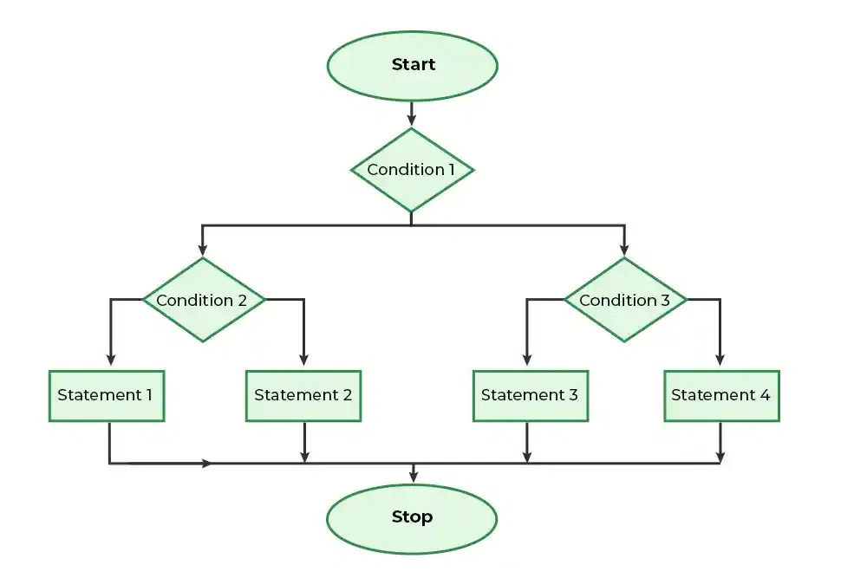
Nested if-else in C
Flowchart of Nested if-else
Syntax of Nested if-else
if (condition1) {
// Executes when condition1 is true
if (condition2) {
// Executes when condition2 is true
}
else{
// Executes when condition2 is false
}
}
else{
//execute when condition-1 is not true
}

Slide 19
// Program to compare two integers using =, > , <
#include <stdio.h>
int main() {
int number1, number2;
printf("Enter two integers: ");
scanf("%d %d", &number1, &number2);
if (number1 >= number2)
{
if (number1 == number2)
{
printf("Result: %d = %d",number1,number2);
}
else{
printf("Result: %d > %d", number1, number2);
}
}
else {
printf("Result: %d < %d",number1, number2);
}
}
Output:
Enter two integers: 3 5
Result: 3 < 5
// C program to illustrate nested-if statement
#include <stdio.h>
int main()
{
int i = 10;
if (i == 10)
{
if (i < 15)
printf("i is smaller than 15\n");
if (i < 12)
printf("i is smaller than 12 too\n");
else
printf("i is greater than 15");
}
}
Output
i is smaller than 15
i is smaller than 12 too

Slide 20
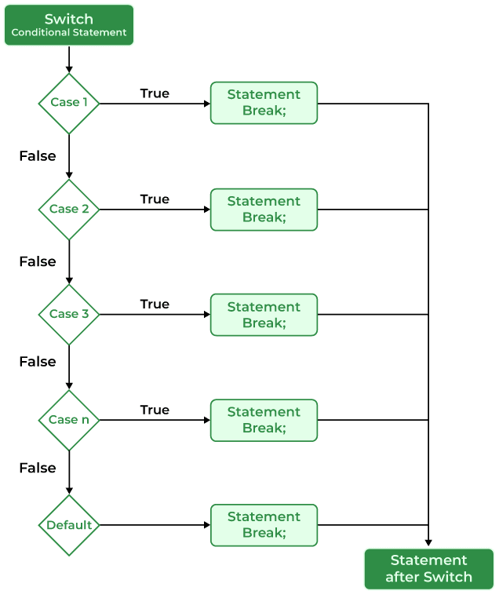
switch Statement in C
The switch case statement is an alternative to the if else if ladder that can be used to execute the conditional code based on the value of the variable specified in the switch statement.
Syntax of switch Statement in C
switch(expression)
{
case value1:
statement_1;
break;
case value2:
statement_2;
break;
.
.
case value_n:
statement_n;
break;
default: default_statement;
}
Note: The switch expression should evaluate to either integer or character. It cannot evaluate any other data type.
Flowchart of switch

Slide 21
// An example of switch case
#include <stdio.h>
int main(){
int var = 1;
switch (var) {
case 1:
printf("Case 1 is Matched.");
break;
case 2:
printf("Case 2 is Matched.");
break;
case 3:
printf("Case 3 is Matched.");
break;
default:
printf("Default case is Matched.");
break;
}
}
Output: Case 1 is Matched.
// switch case without break keyword
#include <stdio.h>
int main(){
int var = 2;
switch (var) {
case 1:
printf("Case 1 is executed.\n");
case 2:
printf("Case 2 is executed.\n");
case 3:
printf("Case 3 is executed.");
case 4:
printf("Case 4 is executed.");
}
}
Output
Case 2 is executed.
Case 3 is executed.Case 4 is executed.

Slide 22
Q-1: Use of Break in switch case
This keyword is used to stop the execution inside a switch block. It helps to terminate the switch block and break out of it. When a break statement is reached, the switch terminates, and the flow of control jumps to the next line following the switch statement.
The break statement is optional. If omitted, execution will continue on into the next case. The flow of control will fall through to subsequent cases until a break is reached.
Q-2: Use of Default in switch case
The default keyword is used to specify the set of statements to execute if there is no case match.
It is optional to use the default keyword in a switch case. Even if the switch case statement does not have a default statement, it would run without any problem.

Slide 23
Q-3: Important Characteristics About Switch Case Statements
1. Switch expression should result in a constant value
If the expression provided in the switch statement does not result in a constant value, it would not be valid. Some valid expressions for switch case will be,
// Constant expressions allowed
switch(1+2+23)
switch(1*2+3%4)
// Variable expression are allowed provided
// they are assigned with fixed values
switch(a*b+c*d)
switch(a+b+c)
2. Expression value should be only of int or char type.
The switch statement can only evaluate the integer or character value. So the switch expression should return the values of type int or char only.
3. Case Values must be Unique
In the C switch statement, duplicate case values are not allowed.
4. Nesting of switch Statements
Nesting of switch statements is allowed, which means you can have switch statements inside another switch. However nested switch statements should be avoided as it makes the program more complex and less readable.
5. The default block can be placed anywhere
Regardless of its placement, the default case only gets executed if none of the other case conditions are met. So, putting it at the beginning, middle, or end doesn’t change the core logic.

Slide 24
Example 1: C Program to print the day of the week using a switch case.
#include <stdio.h>
int main(){
int day = 2;
printf("The day with number %d is ", day);
switch (day) {
case 1:
printf("Monday");
break;
case 2:
printf("Tuesday");
break;
case 3:
printf("Wednesday");
break;
case 4:
printf("Thursday");
break;
case 5:
printf("Friday");
break;
case 6:
printf("Saturday");
break;
case 7:
printf("Sunday");
break;
default:
printf("Invalid Input");
break;
}
}
Output: The day with number 2 is Tuesday

Slide 25
Example 2: Simple Calculator using switch case in C
#include <stdio.h>
#include <stdlib.h>
int main(){
char choice;
int x, y;
while (1) {
printf("Enter the Operator (+,-,*,/) \nEnter x to exit: \n");
scanf(" %c", &choice);
if (choice == 'x') {
exit(0);
}
printf("Enter the two numbers: ");
scanf("%d %d", &x, &y);
switch (choice) {
case '+':
printf("%d + %d = %d\n", x, y, x + y);
break;
case '-':
printf("%d - %d = %d\n", x, y, x - y);
break;
case '*':
printf("%d * %d = %d\n", x, y, x * y);
break;
case '/':
printf("%d / %d = %d\n", x, y, x / y);
break;
default:
printf("Invalid Operator Input\n");
}
}
}

Slide 26
What are the differences between switch and if else if ladder in C?
switch | if - else if
It executes the different cases on the basis of the value of the switch variable. | It executes the different blocks based on the condition specified.
It can only evaluate the int or char type expressions. | It can evaluate any type of expression.
Faster and easier to read for the large number of conditions. | It can get messy when there are lots of conditions.

Slide 27
Important programs in control statements [ if - else ]
if-else:
--------
1. basic [ if ] and [ if-else ] and [ if-else-if ]
2. only use if ladder for multiple statements
3. C Program to check whether the number is even or odd.
4. C program for voting system
5. print weeks day
6. calculator using
7. Program to compare two integers using =, > , <
8. C Program to find out if a number is positive or negative or 0
9. check alphabet or not
10. find vowel or consonant
11.Grade According to marks
12. largest among three numbers
13. smallest among three numbers
14. check leap year
switch:
--------
1. switch case basic example
2. switch case without break keyword
3. C Program to check whether the number is even or odd.
4. C program for voting system
5. print weeks day
6. calculator using

Slide 28
Example–1-a. basic [ if ] and [ if-else ] and [ if-else-if ]
int main()
{ int x;
printf("Enter a number : ");
scanf("%d", &x);
if(x >= 6){
printf("Number >= 6\n");
}
else if(x == 5){
printf("Number = 5\n");
}
else if(x == 4){
printf("Number = 4\n");
}
}
else if(x == 3){
printf("Number = 3\n");
}
else if(x == 2){
printf("Number = 2\n");
}
else {
printf("Number <= 1\n");
}

Slide 29
Example-1-b. switch case basic example
int main(){
int x; ///basic switch case
printf("Enter a number : ");
scanf("%d", &x);
switch(x){
case 6:
printf("number = 6\n");
break;
case 5:
printf("number = 5\n");
break;
case 4:
printf("number = 4\n");
break;
case 3:
printf("number = 3\n");
break;
case 2:
printf("number = 2\n");
break;
default:
printf("number <= 1\n");
break;
}
}

Slide 30
Example-2-a. only use if ladder for multiple statements
#include<stdio.h>
int main()
{
int x;
printf("Enter a number : ");
scanf("%d", &x);
if(x >= 6){
printf("Number >= 6\n");
}
if(x >= 5){
printf("Number = 5\n");
}
if(x >= 4){
printf("Number = 4\n");
}
}
if(x >= 3){
printf("Number = 3\n");
}
if(x >= 2){
printf("Number = 2\n");
}
else {
printf("Number <= 1\n");
}

Slide 31
2. switch case without break keyword
#include<stdio.h>
int main(){
int x;
printf("Enter a number : ");
scanf("%d", &x);
switch(x){
case 6:
printf("number = 6\n");
case 5:
printf("number = 5\n");
case 4:
printf("number = 4\n");
case 3:
printf("number = 3\n");
case 2:
printf("number = 2\n");
default:
printf("value not matched\n");
}
}

Slide 32
3. C Program to check whether the number is even or odd.
#include<stdio.h>
int main()
{
int number;
scanf("%d", &number);
number = abs(number);
int result = number % 2 ;
if(result == 0)
{
printf("Even\n");
}
else{
printf("Odd\n");
}
}
#include<stdio.h>
int main(){
int number;
scanf("%d", &number);
number = abs(number);
int result = number % 2 ;
switch(result){
case 0:
printf("Even");
break;
case 1:
printf("Odd");
break;
default:
printf("Invalid statements");
}
}

Slide 33
4. C program to check voting eligibility
#include<stdio.h>
int main(){
int age;
scanf("%d", &age);
if(age >= 18){
printf("You can vote\n");
}
else{
printf("You can't vote\n");
}
}
#include<stdio.h>
int main(){
int age;
scanf("%d", &age);
switch(age >= 18)
{
case 0:
printf("You can't vote\n");
break;
case 1:
printf("You can vote\n");
break;
}
}

Slide 34
5-a. print day names of weeks
else if(day == 5){
printf("Thursday\n");
}
else if(day == 6){
printf("Friday\n");
}
else if(day == 7){
printf("Saturday\n");
}
else{
printf("Invalid input\n");
}
}
#include<stdio.h>
int main(){
int day;
scanf("%d", &day);
if(day == 1){
printf("Sunday\n");
}
else if(day == 2){
printf("Monday\n");
}
else if(day == 3){
printf("Tuesday\n");
}
else if(day == 4){
printf("Wednesday\n");
}

Slide 35
5-b. print day names of weeks
#include<stdio.h>
int main(){
int day;
scanf("%d", &day);
switch(day)
{
case 1:
printf("Sunday\n");
break;
case 2:
printf("Monday\n");
break;
case 3:
printf("Tuesday\n");
break;
case 4:
printf("Wednesday\n");
break;
case 5:
printf("Thursday\n");
break;
case 6:
printf("Friday\n");
break;
case 7:
printf("Saturday\n");
default:
printf("Invalid");
}
}

Slide 36
6-a.Simple calculator using if else
else if(sign == '%'){
printf("%d %c %d = %d\n", a, sign, b, a%b);
}
else{
printf("Invalid Sign");
}
}
#include<stdio.h>
int main(){
int a,b;
char sign;
scanf("%d %c %d", &a, &sign, &b);
if(sign == '+'){
printf("%d %c %d = %d\n", a, sign, b, a+b);
}
else if(sign == '-'){
printf("%d %c %d = %d\n", a, sign, b, a-b);
}
else if(sign == '*'){
printf("%d %c %d = %d\n", a, sign, b, a*b);
}
else if(sign == '/'){
printf("%d %c %d = %0.2f\n", a, sign, b, (float)a/b);
}

Slide 37
6-b.Simple calculator using switch case
#include<stdio.h>
int main(){
int a,b;
char sign;
scanf("%d %c %d", &a, &sign, &b);
switch(sign) {
case '+':
printf("%d %c %d = %d\n", a, sign, b, a+b);
break;
case '-':
printf("%d %c %d = %d\n", a, sign, b, a-b);
break;
case '*':
printf("%d %c %d = %d\n", a, sign, b, a*b);
break;
case '/':
printf("%d %c %d = %0.2f\n", a, sign, b, (float)a/b);
break;
case '%':
printf("%d %c %d = %d\n", a, sign, b, a%b);
break;
default:
printf("Invalid Sign");
}
}

Slide 38
#include<stdio.h>
int main(){
///num1 > num2 or num1 < num2 or num1 == num2
int num1, num2;
scanf("%d %d", &num1, &num2);
if(num1 > num2){
printf("%d > %d\n", num1, num2);
}
else if(num1 < num2){
printf("%d < %d\n", num1, num2);
}
else{
printf("%d == %d\n", num1, num2);
}
}
7. Program to compare two integers using =, > , <

Slide 39
8. C Program to find out if a number is positive or negative or 0
#include<stdio.h>
int main(){
int n;
scanf("%d", &n);
if(n > 0) {
printf("Positive\n");
}
else if(n < 0){
printf("Negative\n");
}
else{
printf("Zero");
}
}

Slide 40
9. check alphabet(a-z , A-Z) or not
#include<stdio.h>
int main(){
char input;
scanf("%c", &input);
///method -1
if( input>='a' && input<='z'){
printf("alphabet[smaller]\n");
}
else if(input>='A' && input<='Z'){
printf("alphabet[upper]\n");
}
else{
printf("Not an alphabet\n");
}
///method-2
if (isalpha(input) == 0)
printf("not an alphabet.");
else
printf("alphabet");
}

Slide 41
10. find vowel[a, e, I, o, u] or consonant
#include <stdio.h>
int main() {
char vowel;
printf("Enter an alphabet: ");
scanf("%c", &vowel);
if(vowel == 'a' || vowel == 'A'){
printf("Vowel\n");
}
else if(vowel == 'e' || vowel == 'E'){
printf("Vowel\n");
}
else if(vowel == 'i' || vowel == 'I'){
printf("Vowel\n");
}
else if(vowel == 'o' || vowel == 'O'){
printf("Vowel\n");
}
else if(vowel == 'u' || vowel == 'U'){
printf("Vowel\n");
}
else{
printf("Consonant\n");
}
}

Slide 42
11.Grade According to marks
else if(marks>=65 && marks<=69){
printf("You got \"B+\" \n");
}
else if(marks>=60 && marks<=64){
printf("You got \"B\" \n");
}
else{
printf("You failed\n");
}
}
#include<stdio.h>
int main()
{
int marks;
scanf("%d", &marks);
if(marks>=80 && marks<=100){
printf("You got \"A+\" \n");
}
else if(marks>=75 && marks<=79){
printf("You got \"A\" \n");
}
else if(marks>=70 && marks<=74){
printf("You got \"A-\" \n");
}

Slide 43
12. largest among three numbers
#include <stdio.h>
int main() {
int n1, n2, n3;
///type-1
printf("Enter three different numbers: ");
scanf("%d %d %d", &n1, &n2, &n3);
if (n1 >= n2 && n1 >= n3)
printf("%d is the Largest Number\n", n1);
if (n2 >= n1 && n2 >= n3)
printf("%d is the Largest Number\n", n2);
if (n3 >= n1 && n3 >= n2)
printf("%d is the Largest Number\n", n3);
///type-2
if (n1 >= n2 && n1 >= n3)
printf("%d is the largest number\n", n1);
else if (n2 >= n1 && n2 >= n3)
printf("%d is the largest number\n", n2);
else
printf("%d is the largest number\n", n3);
}

Slide 44
13. smallest among three numbers
#include <stdio.h>
int main() {
int n1, n2, n3;
///type-1
printf("Enter three different numbers: ");
scanf("%d %d %d", &n1, &n2, &n3);
if (n1 <= n2 && n1 <= n3)
printf("%d is the Smallest Number\n", n1);
if (n2 <= n1 && n2 <= n3)
printf("%d is the Smallest Number\n", n2);
if (n3 <= n1 && n3 <= n2)
printf("%d is the Smallest Number\n", n3);
///type-2
if (n1 <= n2 && n1 <= n3)
printf("%d is the Smallest number\n", n1);
else if (n2 <= n1 && n2 <= n3)
printf("%d is the Smallest number\n", n2);
else
printf("%d is the Smallest number\n", n3);
}

Slide 45
14. check leap year
#include<stdio.h>
int main(){
int year;
printf("Enter a year: ");
scanf("%d", &year);
if(year % 400 == 0){
printf("%d is a leap year\n", year);
}
else if (((year % 4 == 0) && (year % 100!= 0))){
printf("%d is a leap year\n", year);
}
else{
printf("%d is not a leap year\n", year);
}
}

Slide 46
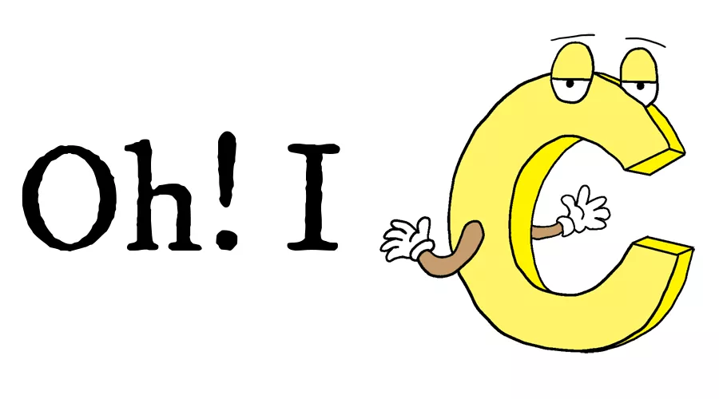
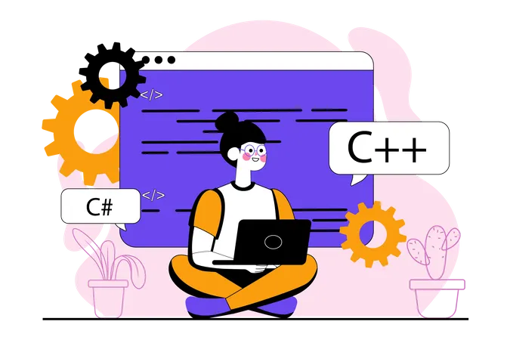

What is Loop?
Loop
Loop
while()
for()
Loop
do while()
What is Loop?
What is Loop?
while()
Loop
Loop
Loop
Loop
do while()
Loop
for()

Slide 47
C – Loops
Loops in programming are used to repeat a block of code until the specified condition is met. A loop statement allows programmers to execute a statement or group of statements multiple times without repetition of code.
#include <stdio.h>
int main()
{
printf( "Hello World\n");
printf( "Hello World\n");
printf( "Hello World\n");
printf( "Hello World\n");
printf( "Hello World\n");
printf( "Hello World\n");
printf( "Hello World\n");
printf( "Hello World\n");
printf( "Hello World\n");
printf( "Hello World\n");
}
Output
Hello World
Hello World
Hello World
Hello World
Hello World
Hello World
Hello World
Hello World
Hello World
Hello World

Slide 48
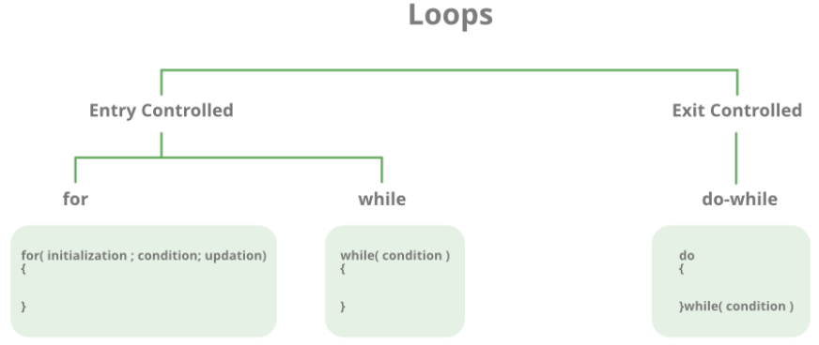
There are mainly two types of loops in C Programming:
Entry Controlled loops: In Entry controlled loops the test condition is checked before entering the main body of the loop. For Loop and While Loop is Entry-controlled loops.
Exit Controlled loops: In Exit controlled loops the test condition is evaluated at the end of the loop body. The loop body will execute at least once, irrespective of whether the condition is true or false. do-while Loop is Exit Controlled loop.

Slide 49
Loop Type | Description
for loop | first Initializes, then condition check, then executes the body and at last, the update is done.
while loop | first Initializes, then condition checks, and then executes the body, and updating can be inside the body.
do-while loop | do-while first executes the body and then the condition check is done.
for Loop
for loop in C programming is a repetition control structure that allows programmers to write a loop that will be executed a specific number of times. for loop enables programmers to perform n number of steps together in a single line.
Syntax:
for (initialize expression; test expression; update expression)
{
// body of for loop
}
Example:
for(int i = 0; i < n; ++i)
{
printf("Body of for loop which will execute till n");
}

Slide 50
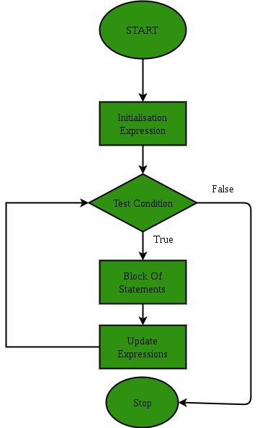
If the test condition will be false then it will stop.
Initialization Expression: In this expression, we assign a loop variable or loop counter to some value. for example: int i=1;
Test Expression: In this expression, test conditions are performed. If the condition evaluates to true then the loop body will be executed and then an update of the loop variable is done. If the test expression becomes false then the control will exit from the loop. for example, i<=9;
Update Expression: After execution of the loop body loop variable is updated by some value it could be incremented, decremented, multiplied, or divided by any value.

Slide 51
#include <stdio.h>
// Driver code
int main()
{
int i = 0;
for (i = 1; i <= 10; i++)
{
printf( "Hello World\n");
}
}
Output
Hello World
Hello World
Hello World
Hello World
Hello World
Hello World
Hello World
Hello World
Hello World
Hello World

Slide 52
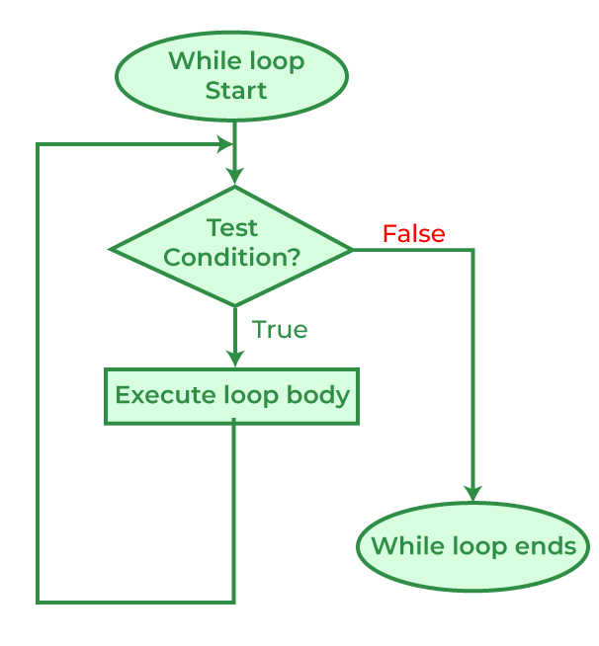
While Loop
While loop does not depend upon the number of iterations. In for loop the number of iterations was previously known to us but in the While loop, the execution is terminated on the basis of the test condition. If the test condition will become false then it will break from the while loop else body will be executed.
Syntax:
initialization_expression;
while (test_expression)
{
// body of the while loop
update_expression;
}

Slide 53
#include <stdio.h>
int main()
{
int i = 2;
while(i < 10)
{
printf( "Hello World\n");
i++;
}
}
Output
Hello World
Hello World
Hello World
Hello World
Hello World
Hello World
Hello World
Hello World

Slide 54
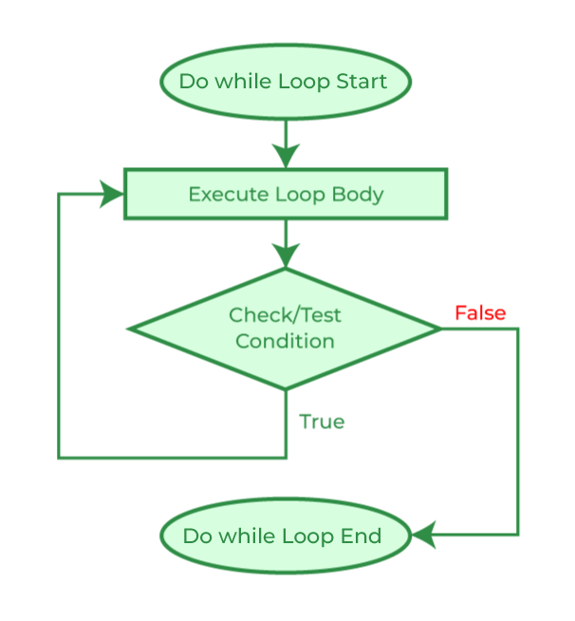
do-while Loop
The do-while loop is similar to a while loop but the only difference lies in the do-while loop test condition which is tested at the end of the body. In the do-while loop, the loop body will execute at least once irrespective of the test condition.
Syntax:
initialization_expression;
do
{
// body of do-while loop
update_expression;
} while (test_expression);

Slide 55
#include <stdio.h>
int main()
{
// Initialization expression
int i = 2;
do{
// loop body
printf( "Hello World\n");
// Update expression
i++;
// Test expression
} while (i < 1);
}
Output
Hello World

Slide 56
Loop Control Statements
Name | Description
break statement | the break statement is used to terminate the switch and loop statement. It transfers the execution to the statement immediately following the loop or switch.
continue statement | continue statement skips the remainder body and immediately resets its condition before reiterating it.
goto statement | goto statement transfers the control to the labeled statement.

Slide 57
#include <stdio.h>
int main()
{
while (1)
printf("This loop will run forever.\n");
}
Infinite Loop
#include <stdio.h>
int main ()
{
int i;
for ( ; ; )
{
printf("This loop will run forever.\n");
}
}
Output
This loop will run forever.
This loop will run forever.
This loop will run forever.
...
Output
This loop will run forever.
This loop will run forever.
This loop will run forever.
...
#include <stdio.h>
int main()
{
do
{
printf("This loop will run forever.\n");
} while (1);
}
Output
This loop will run forever.
This loop will run forever.
This loop will run forever.
...

Slide 59
Example 2: C Program to check whether a number is prime or not.
#include<stdio.h>
#include<stdbool.h>
int main(){
int n;
scanf("%d", &n);
printf("\n");
if(n<=1){ //n = 0,1
printf("Not prime");
}
else if(n == 2){
printf("Prime!!");
}
else if(n!=2 && n % 2 == 0){ //all even numbers
printf("Not prime");
}
else{
//eikhane shob odd numbers ashbe
bool check = true;
for(int i = 2 ; i<= n - 1 ; i++){
if(n % i == 0){
printf("Not prime");
check = false;
break;
}
}
/// check == false or check == true
if(check == true){
printf("Prime!!");
}
}
printf("\n\n\n");
}

Slide 60
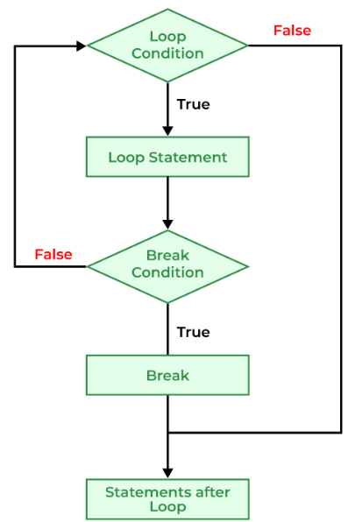
Jump Statements in C
These statements are used in C for the unconditional flow of control throughout the functions in a program. They support four types of jump statements:
A) break
This loop control statement is used to terminate the loop. As soon as the break statement is encountered from within a loop, the loop iterations stop there, and control returns from the loop immediately to the first statement after the loop.
Syntax of break
break;
Use of break in C
Simple Loops
Nested Loops
Infinite Loops
Switch case

Slide 61
// C Program to demonstrate infinite loop without using break statement
#include <stdio.h>
int main(){
int i = 0;
// while loop which will always be true
while (1) {
printf("%d ", i);
i++;
if (i == 5) {
break;
}
}
}
Output: 0 1 2 3 4
Break in C switch case
Syntax of break in switch case
switch(expression)
{
case value1:
statement_1;
break;
case value2:
statement_2;
break;
.....
.....
case value_n:
statement_n;
break;
default:
default statement;
}

Slide 62
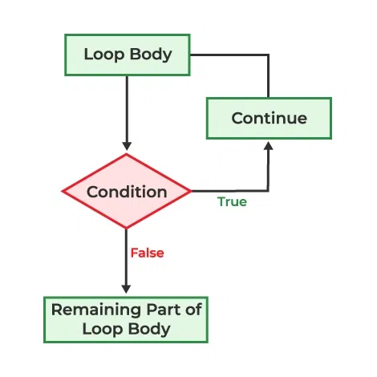
B) continue
This loop control statement is just like the break statement. The continue statement is opposite to that of the break statement, instead of terminating the loop, it forces to execute the next iteration of the loop.
As the name suggests the continue statement forces the loop to continue or execute the next iteration. When the continue statement is executed in the loop, the code inside the loop following the continue statement will be skipped and the next iteration of the loop will begin.
Syntax of continue
continue;
Flowchart of Continue
#include <stdio.h>
int main() {
// loop from 1 to 10
for (int i = 1; i <= 10; i++) {
if (i == 6)
continue;
else
printf("%d ", i);
}
}
Output
1 2 3 4 5 7 8 9 10
Use of continue in C
Single Loops
Nested Loops

Slide 63
What is the difference between break and continue?
break | continue
The break statement terminates the loop and brings the program control out of the loop. | The continue statement terminates only the current iteration and continues with the next iterations.
The syntax is: break; | The syntax is: continue;
The break can also be used in switch case. | Continue can only be used in loops.
What is the use of continue statement in C?
The continue statement in C is used in loops to skip the current iteration and move on to the next iteration without executing the statements below the continue in the loop body.

